Slide 1
Mathematical Models of Self-Assembly
Bobby Lindsey & Richard Harvel

Slide 2

Importance
This field of study is vital to future growth in such fields as
- medicine
- computing
- robotics
- and many more
https://www.youtube.com/watch?v=xK54Bu9HFRw&list=PL53nfRA55GqenlHvuuBrzliiOFQ9mjA4d
From the Harvard School of Engineering and Sciences

Slide 3
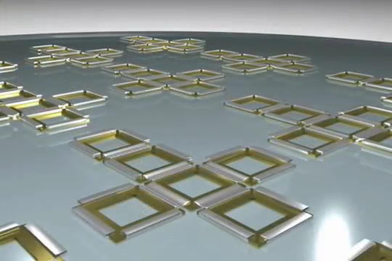
How It Works
Particles begin at an initial position within the space, which may be designed or natural.
Particles receive energy from a stimulus
- magnetic
- surface tension
- temperature change
Particles begin to arrange themselves into larger clusters.
https://www.youtube.com/watch?v=8huH-yB7xdQ
Self Assembling Biomedical Nanoliter Containers

Slide 4
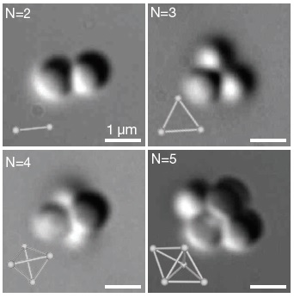
Our Work
Observations for 2, 3, 4, and 5 spheres – no variation

Slide 5
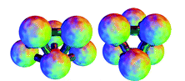
Our Work
Observations of 6 spheres – 2 forms

Slide 6
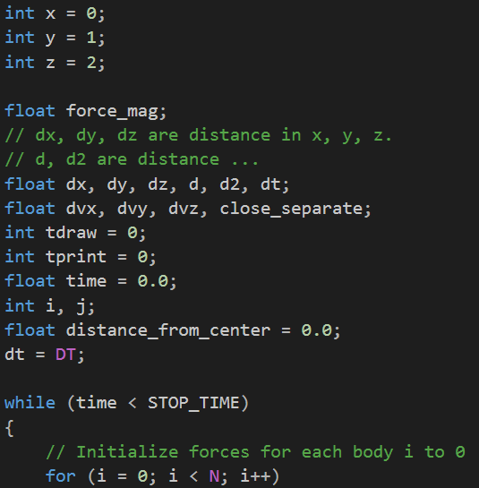
Physical to Virtual
Observing the setup of Harvard’s experiment, we built computer models to create a similar environment
programmed in C
simulated spheres in a 3-dimensional space
applied initial conditions
random starting locations within the space
small force pulling spheres toward the center of the space

Slide 7
Results
100 experiments
2000 experiments
These counts show that polytetrahedrons occur ~20x more often than octahedrons.

Slide 8
Parallel Computing
Taking advantage of parallel computing, we are able to swiftly make millions of calculations. This enables us to generate huge stores of data about the frequency of varying cluster formations.
Additionally, we are able to generate this data on large numbers of spheres, which would be impossible using traditional methods of working with such small particles utilizing methods requiring natural forces such as evaporation.

Slide 9
References
- http://people.seas.harvard.edu/~vnm/pdf/Meng-Science-2010-postprint.pdf [this is the paper reference, it needs to look more fancy probably…]

Slide 10
Thank You !

